Slide 1
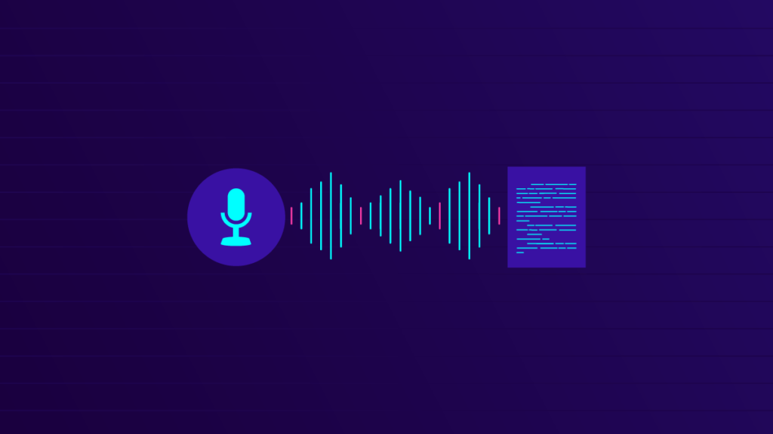

Automatic Speech Recognition

Slide 2
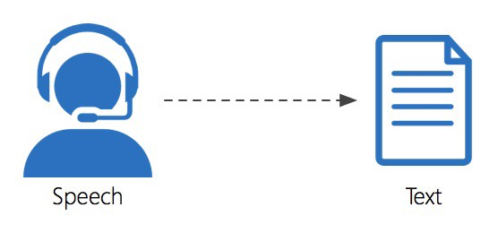
What is ASR?
An ASR system “understand” the given input of sound waves and covert into text format.
Ideal ASR System should be able to recognize the spoken utterances accurately
Notes:
Nearly gone are the days of typing and Now we want to use the power of speech or vocal chord to interact with devices.

Slide 3
What we expect from Speech recognition systems?
Global Vocabulary
Noise Robustness
Automatic Punctuation
Accuracy
Notes:
To recognize more languages with an extensive vocabulary
System should handle the noise in the environment
We do not pronounce the punctuation but for ideal ASR system, we expect to see the proper punctuation for the text like capitalization, comma pause.

Slide 4
Why is ASR desirable for all Languages?
Speech is the primary means of human communication
Develop Interface for both literate and moderate users
It can also contribute to preserve the endangered languages
We have around 7000 languages and around 100 languages (only) have matured ASR system
Notes:
So these days without a thought we use voice to search and instead of typing we just use voice and our text messages are just rendered.
Social desirable aspect

Slide 5
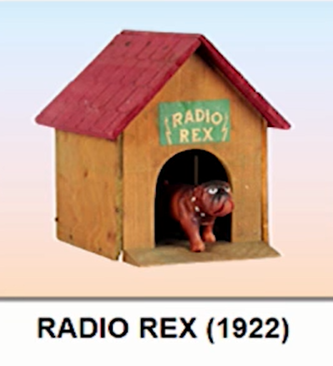
HISTORY OF ASR
Frequency of Female Voice = 165-255 HZ
Frequency of Male Voice = 85-185 HZ
1922
Automatic Speech Recognition: A Review, December 2012
Notes:
Radio Rex was the first commercial toy to respond to voice commands. There was a tiny dog connected with a spring inside a house. It was controlled by electromagnet.
It was sensitive to frequency 500 HZ. When someone says ReX the dog jumps out of the house. It was a cute prototype but it does not work for women or children, just for
And responds to just Adult man. So it was recognizing only one word.

Slide 6
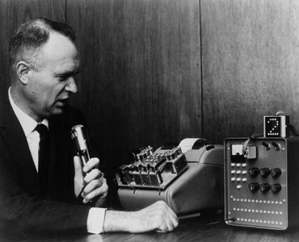
HISTORY OF ASR
ShoeBox (IBM) 1-16 isolated words
1 word
1922
1962
Automatic Speech Recognition: A Review, December 2012
Notes:
In 1962 IBM demonstrated this system it recognized 16 words. There is a slow progress from 1 word to 16 words. These were isolated word recognition

Slide 7
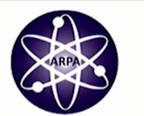
HISTORY OF ASR
HARPY-1976 connected words
16 words
isolated
1 word
1922
1962
Automatic Speech Recognition: A Review, December 2012
Notes:
Now this was an influential year for speech recognition. HARPY system was able to successfully recognize 1000 of connected words

Slide 8
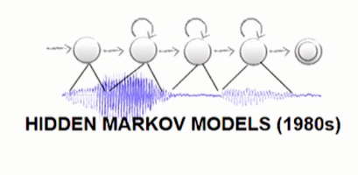
HISTORY OF ASR
10K+ words with LVCSR
1000 words
Connected
Speech
16 words
isolated
1 word
1922
1962
1976
Automatic Speech Recognition: A Review, December 2012
Notes:
Later on the statistical model for speech recognition were introduced and HMM played important role in pushing the state of the art.
It recognized 10K+ words with large vocabulary Continuous Speech Recognition.

Slide 9
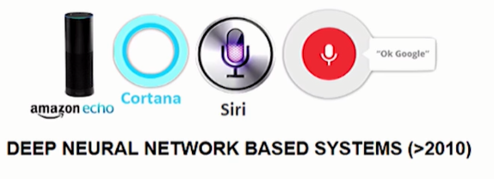
HISTORY OF ASR
1000 words
Connected
Speech
10K+ words
LVCSR System
16 words
isolated
1 word
1922
1962
1976
1982
2012
Automatic Speech Recognition: A Review, December 2012
Notes:
Now we are in the age of deep neural network. All the speech recognition systems are using deep neural based systems

Slide 10
HISTORY OF ASR
1000 words
Connected
Speech
10K+ words
LVCSR System
Fully connected (DNNs)
Convolutional Networks (CNNs)
Recurrent Neural Networks (RNNs)
LSTMs
GRUs
16 words
isolated
1 word
1922
1962
1976
1982
2012
2017 . . .
Automatic Speech Recognition: A Review, December 2012
Notes:
Nowadays, (LSTM), is being used for speech recognition in combination with different deep learning techniques

Slide 11


Industry report
STATISTA
FOUND THAT APPROXIMATELY 64% OF SURVEYED EXPERTS WITHIN THE INDUSTRIES OF E-LEARNING AND MARKET RESEARCH USED SPEECHTO-TEXT AUTOMATED TRANSCRIPTION IN 2020
TECHCRUNCH
REPORTS THAT THE NUMBER OF DEVICES WITH VOICE ASSISTANTS INSTALLED IN 2020 WAS OVER TWO
BILLION
Facebook
claims that people now watch over 100 million hours of video on Facebook each day. the captioned video ads increase video view time by an average of 12%
Google
27% of the global online population is using voice search on mobile.
Notes:
.
seven out of ten consumers (71 percent) prefer to use voice searches over the traditional method of typing

Slide 12
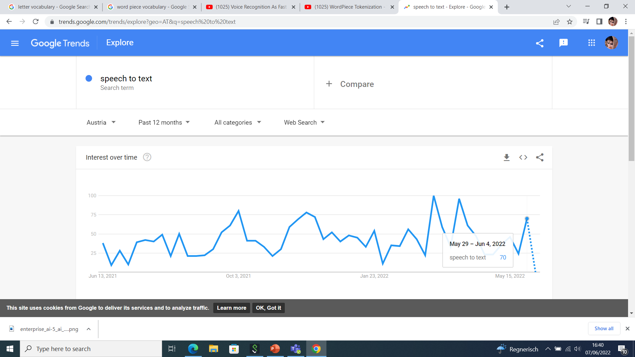
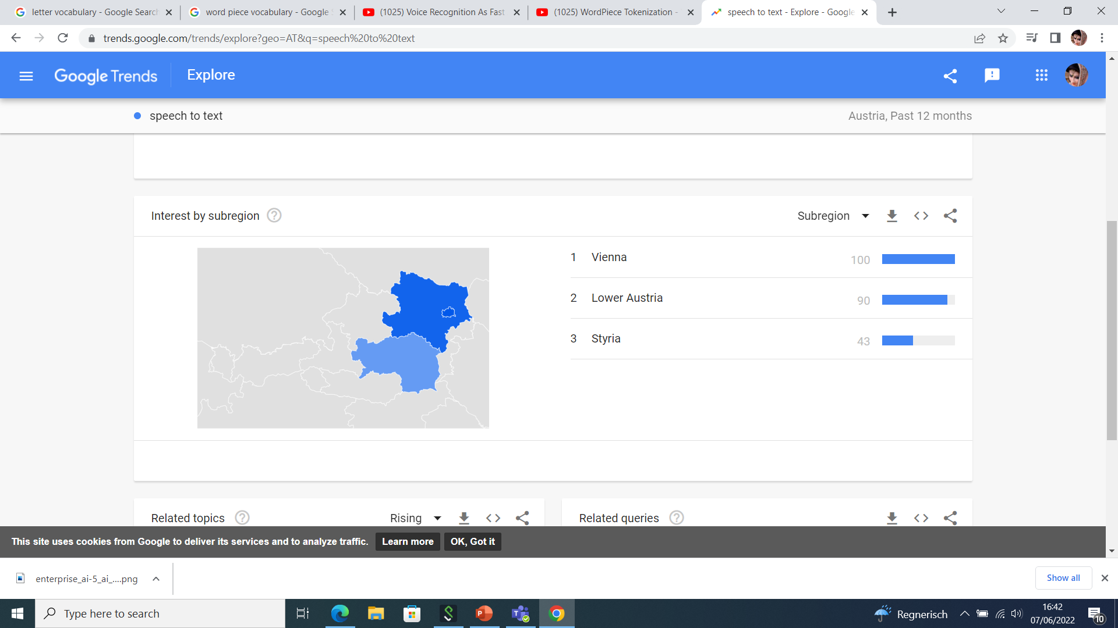
Notes:
According to the results on Google trends Speech to text domain is on more focus in last 12 months.

Slide 13
Speech Representation:
Sound is produced by changing air pressure produced through the excitation from vocal cords
The sound is modulated by moving/shaping of mouth (tongue, teeth, lips)
Sound Frequency
Human Hearing Frequency Range: 20HZ to 20KHZ (approx.)
Human Speech: 85 HZ to 8KHZ (approx.)
For ASR Speech processing is mostly done around 16 KHZ 16bits/sample

Slide 14
Challenges for Speech recognition Systems
Handling noisy real-life settings with multiple speakers (e.g. meetings, parties)
High Quality embedded ASR System to run locally on mobile phones
Reduce duplicate efforts across multiple dialects/languages
Should be robust to variation in age, accent
Should be able to handle coding switching and code mixing which is common in multilingual
Notes:
So the problems with ASR systems now a days is to handle noisy environment when multiper speakers are speaking
There is a challenge to develop embedded system which are doing offline speech recognition with low latency and and computational head but with high accuracy
Transfer learning techniques for reducing duplicating dialects
System should be robust to the variation in age accents

Slide 15
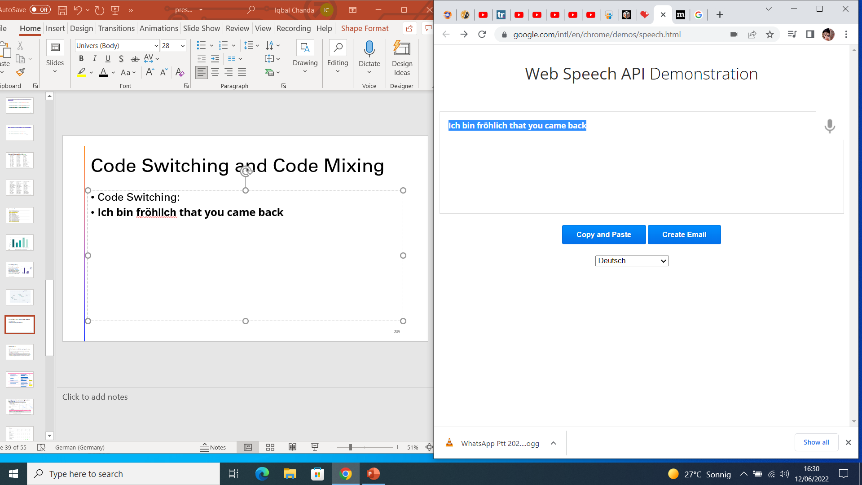
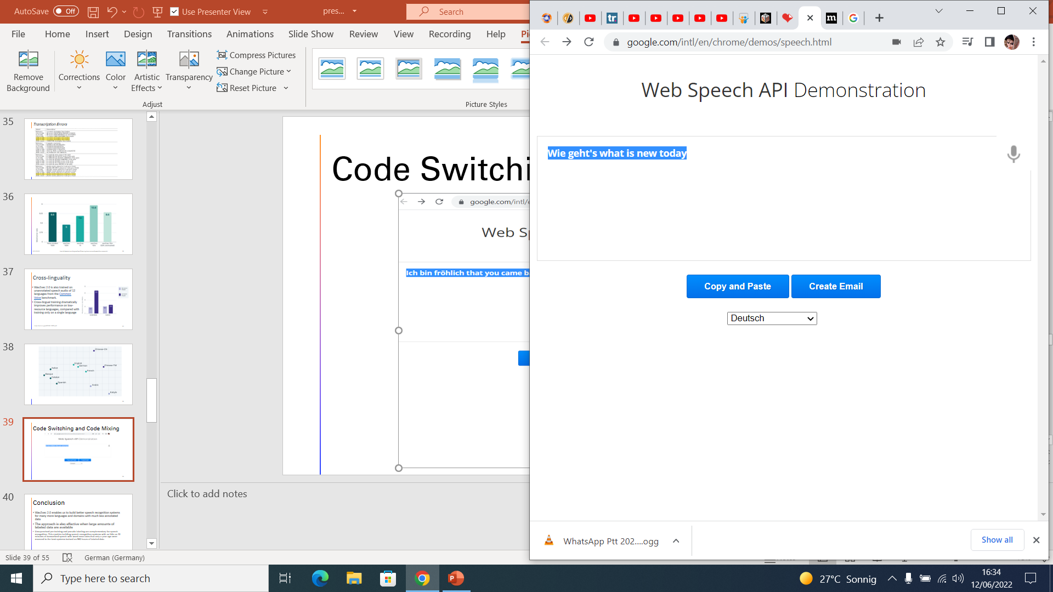
Code Switching and Code Mixing

Slide 16

Accents in Speech Recognition
Accents in Speech Recognition are serious challenges
REF:
A year before his retirement he was appointed Chaplain of the Swedish Royal Household.
Test:
Before his retirement he was appointed champion of the world
Recording Sample from commonvoice.mozilla.org/en
Testes on Google ASR System
www.google.com/intl/en/chrome/demos/speech.html
Notes:
The voice sample is from mozilla commonvoice corpus. These error should not have been there if it was clean or pronounced clearly. I have tested the sample sound on the Google ASR system and it has been trained on 12 accents for English Language

Slide 17
Speech is really a next computer interface

Slide 18
What we need to build a speech recognition system?
Speech recognition systems learn from human
Language Model
Lexicon Model
Acoustic Model
Speech
Text
Notes:
So first of all to build a speech recognition system we need a lot of data Speech data (audio data) and text (transcription) . Then this speech and text data is used to train the acoustic model. These acoustic models are the general purpose representations of speech sounds (pitch, phonetic, wavelength, frequency) in a language. Then we need lexicon which lists all the words that a recognizer actually recognize.
And lastly we need a language model that tells the probability of the sequence of words occurring in particular language.

Slide 19
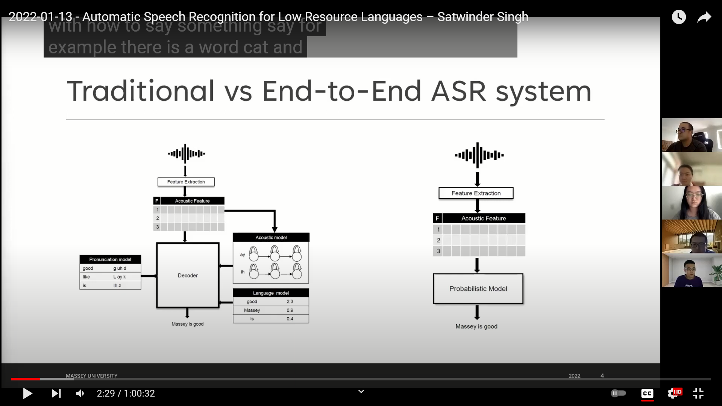
Traditional Vs End to End ASR systems
Audio Input
Audio Input
Sarah is good
Sarah is good
Notes:
The main component of the ASR system. We have features extractor which takes the raw speech waveforms and convert it into some acoustic features. Then we have acoustic model which. is a probabilistic model which maps the features into phonemes. In history HMM were completely used within acoustic models but now a days replaced by DNN CNN RNN.
The third component is pronounciation model. That maps the phonemes to word.
Finally we have language model reorders the word and gives a most likely sequence. It is also a probablisitc model. The decoder job is to combine the components and find the best matches for the speech utterance by using graph search algorithms.
Now recent trends are End to End system is to train all the components jointly as a single e2e network. Trained using the pairs of speech clips and corresponding text. And these models outperforms the conventional system

Slide 20
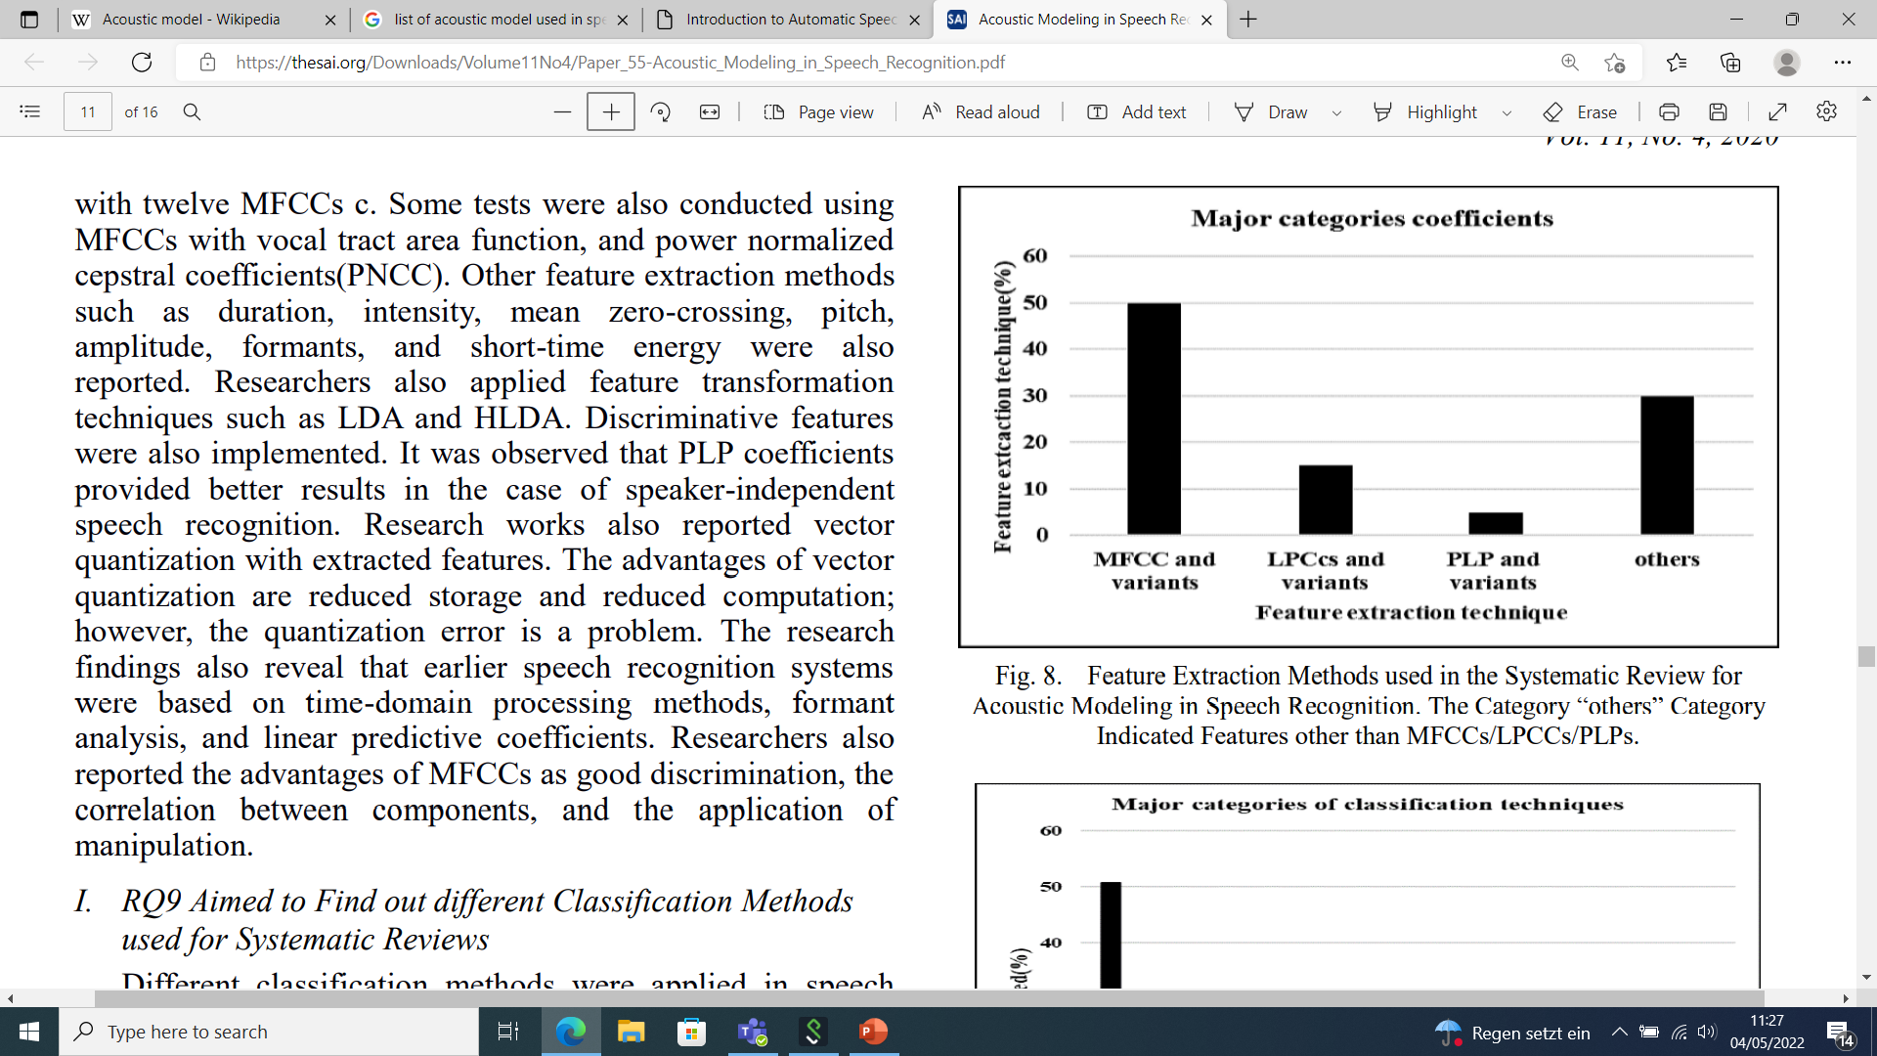
Feature Extraction techniques
Different feature extraction techniques that has been used are as following:
1. Mel-Frequency Cepstrum Coefficients (MFCC)
2. Linear Predictive Coding (LPC)
3. Linear Prediction Cepstral Coefficients (LPCC)
4. Perceptual Linear Prediction (PLP)
5. Linear Discriminant Analysis (LDA)
6. Discrete Wavelet Transform (DWT)
7. Relative Spectral (RASTA-PLP)
8. Principal Component analysis (PCA)
Shohba et al.,2020

Slide 21
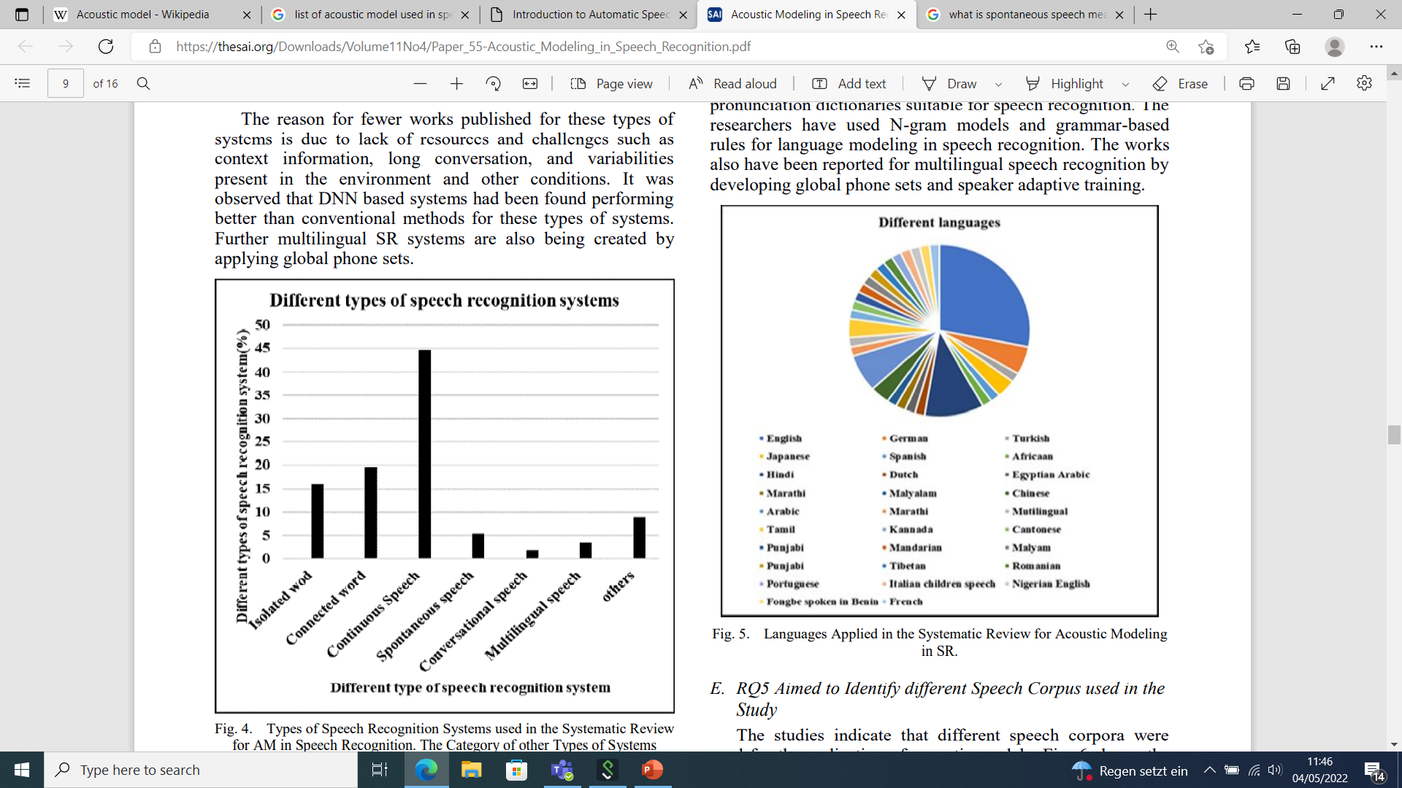
Types of ASR Systems
The research findings indicate:
Significant research work has presented for continuous speech and connected words due to their more applications.
A limited work has been reported towards spontaneous speech, conversational speech, and multilingual speech.
Shohba et al.,2020

Slide 22
Evaluation techniques for ASR
The performance of a speech recognition system usually depends on two factors:
The Accuracy of the output produced
The processing Speed of the ASR
Word Error Rate (WER) and Word Recognition Rate (WRR) is used to find the accuracy of system
The Real-time factor (RTF) is the most commonly used metric for calculating the speed of a proposed model

Slide 23
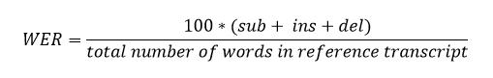
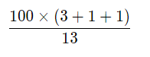
Evaluation automatic speech recognition systems
The standard measurement to assess the performance of an automatic speech recognition (ASR) system is WER (Jelinek, 1997)
Three types of errors can be distinguished:
substitutions (sub) transcribed wrongly
deletions (del) omitted during transcription
insertions (ins) omitted during recording
REF | Speech | is | human | silence | is | divine | *** | we | must | learn | both | of | these | arts
ASR | Speech | is | human | silence | is | there | but | we | must | learn | **** | for | his | arts
Error |  |  |  |  |  | SUB | INS |  |  |  | DEL | SUB | SUB
=
=
38.46%.
Notes:
https://www.italk2learn.com/evaluating-performance-of-automatic-speech-recognition-systems/

Slide 24
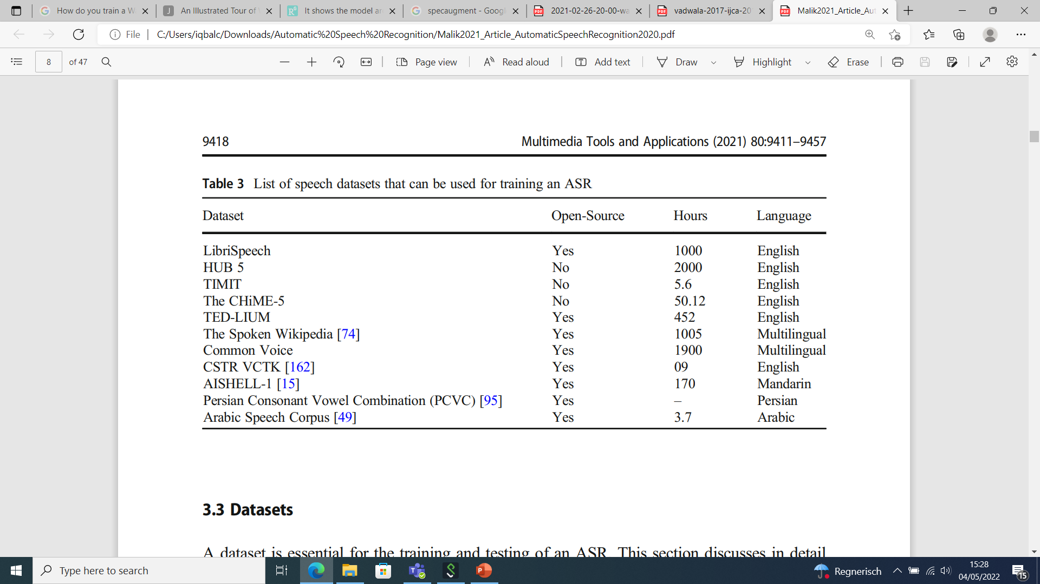
List of datasets that can be used for training ASR
Malik et at., 2021
Notes:
LibriSpeech is one of the most frequently used speech-to-text corpus.

Slide 25
Can computer good at recognizing speech as human?

Slide 26
How does human learn?
Thanks to Semi-Supervised Learning
Notes:
Babies learn to speak by listening to everyday sounds and words.
SSL model is based on human learning. As a child learn to listen first and then learn to write later. It is the exact model like learn to listen corresponds to pretraining the data and learn to write is finetuning the model for best performance.
2019 has been the year where a lot of research has been on self-supervised learning, learning with a limited amount of data.

Slide 27
Why this model (Wav2vec2.0)?
The idea behind the Wav2vec series is semi supervised learning
SOTA models require thousands of hours of transcribed speech
So many data are not available for the vast majority of the nearly 7,000 languages
For noncommercial companies its almost impossible to obtain such an amount of data

Slide 28
Wav2vec2.0
Wav2Vec2 is a pretrained model for Automatic Speech Recognition (ASR) and was released in September 2020
For the first time, it has been shown that pretraining, followed by fine-tuning on very little labeled speech data achieves competitive results to state-of-the-art ASR systems.
With just one hour of labeled training data, it outperforms the previous state of the art— using 100 times less labeled data.
Notes:
architecture is based on the Transformer’s encoder
with a training objective similar to BERT’s masked language modeling objective, but adapted for speech
uses self-supervision to push the boundaries by learning from unlabeled training data to enable speech recognition systems for many more languages,

Slide 29
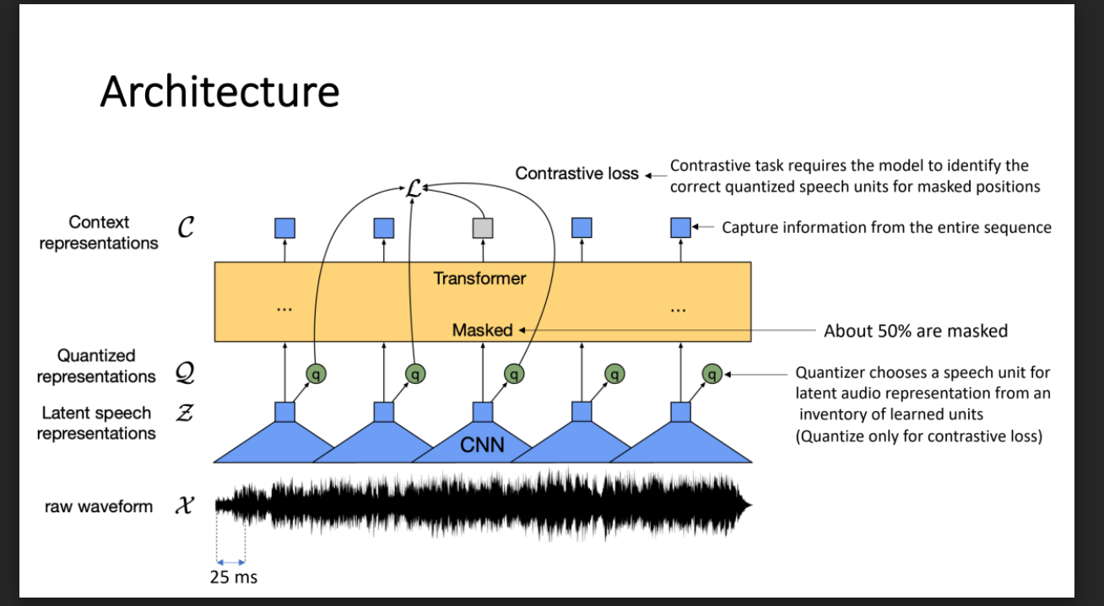
Notes:
The feature encoder, made of several blocks of temporal convolution followed by layer normalization
the output of the feature encoder is fed to a context network that follows the Transformer architecture
the output of the feature encoder (and not of the context transformer) is discretized in parallel using a quantization module that relies on product quantization
Quanitization is the process of converting values from continuous space to discrete.

Slide 30
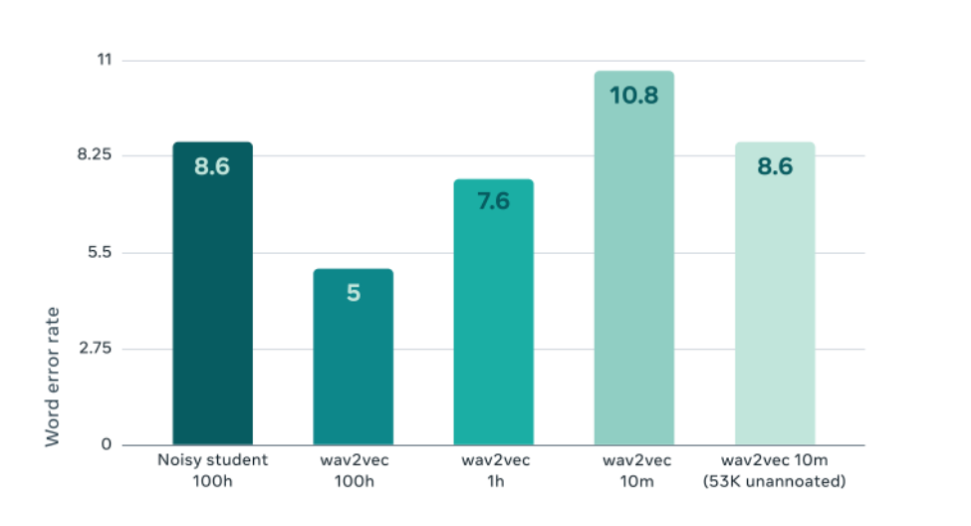
https://ai.facebook.com/blog/wav2vec-20-learning-the-structure-of-speech-from-raw-audio/
Notes:
The result shows a large improvement over the previous state of the art on 100 hours of annotated data (Noisy Student training) when wav2vec 2.0 uses the same amount of annotated data. Moreover, it still shows improvement over the previous best result even when using 100x less annotated data, or just one hour.
What happens if we increase the amount of unannotated data? To answer this question, we trained on 53K hours of unannotated data from the LibriVox dataset (a large collection of public audiobooks) and fine-tuned with only 10 minutes of labeled data. The result was a model that still achieved a WER of 8.6 percent. This demonstrates that wav2vec 2.0 can enable speech recognition models for settings where there is very little labeled training data.

Slide 31
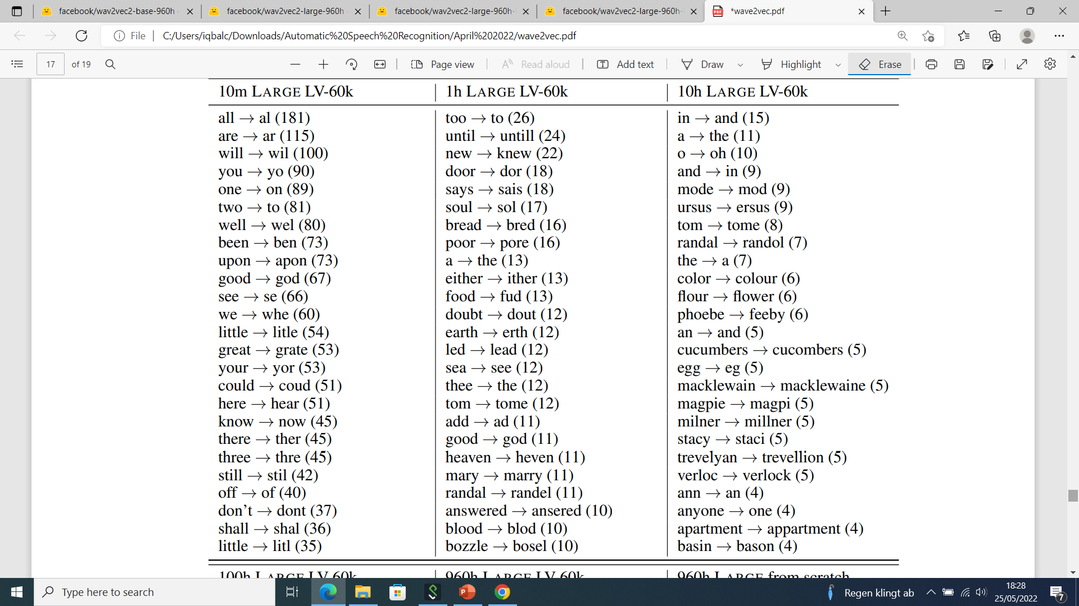
Speech Recognition Errors
Notes:
These are the most common errors the models make when fine-tuned on different amounts of labeled data
In brackets is the total number of occurrences of each error.
In the ten minute labeled data setup, the model is still able to recognize basic units of speech
most errors are around spelling of words
Spelling errors decrease with more labeled data: with one hour of labeled data, slightly less common words move into the list of the most frequent errors,

Slide 32

Notes:
Finally at 960 hours the word error rate falls to 2% and top errors are mostly articles, incorrect splits, and some very rare words or names

Slide 33

Transcription Errors
Notes:
This table shows transcriptions of a few relatively challenging utterances from the dev-clean subset of Librispeech
Capitalized words indicate errors.

Slide 34
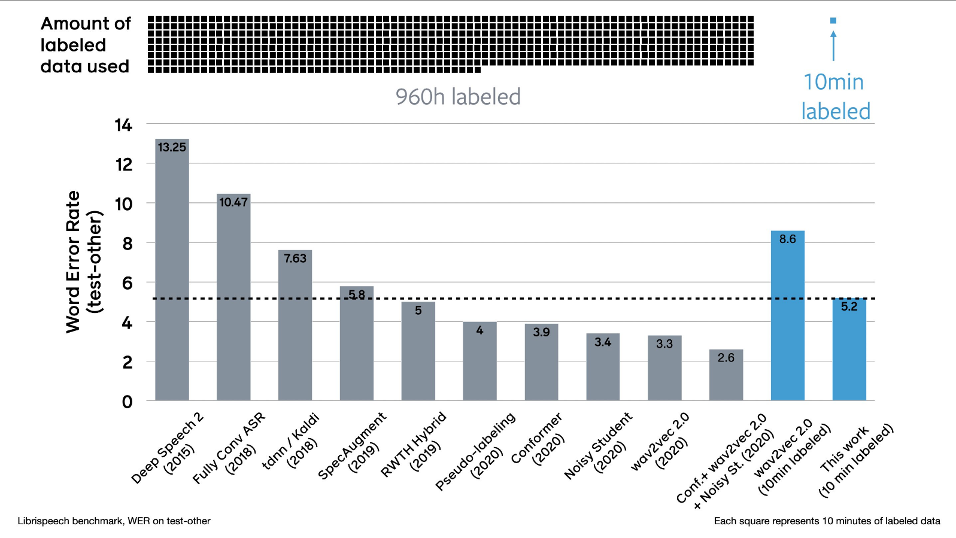
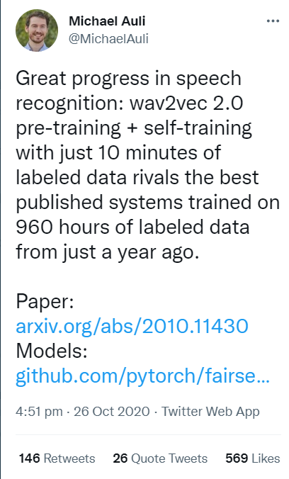
Wav2vec 2.0 Pre-training+Self-Training
Notes:
This last work combines both self-supervised training and pre-training for speech recognition.
It gained a lot of attention lately, especially on Twitter. Just 10 minutes of labelled speech can reach the same WER than a recent system trained on 960 hours of data.

Slide 35
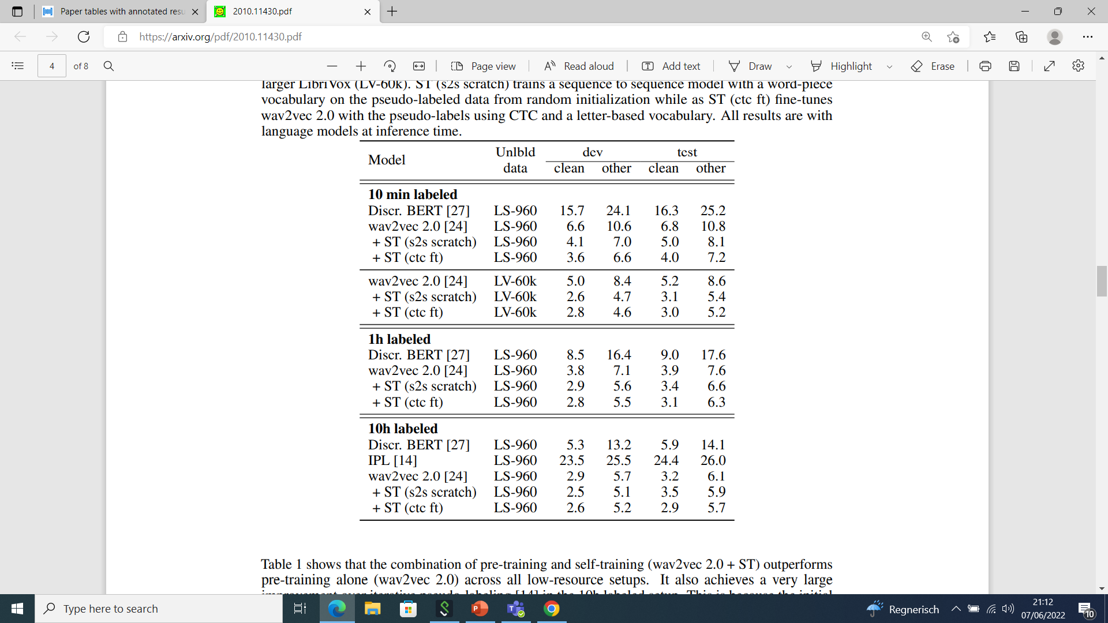
Notes:
shows that the combination of pre-training and self-training (wav2vec 2.0 + ST) outperforms pre-training alone (wav2vec 2.0) across all low-resource setups
It also achieves a very large improvement in the 10h labeled setup
CTC is an algorithm used to train deep neural networks in speech recognition. CTC is used when we don’t know how the input aligns with the output (how the characters in the transcript align to the audio

Slide 36
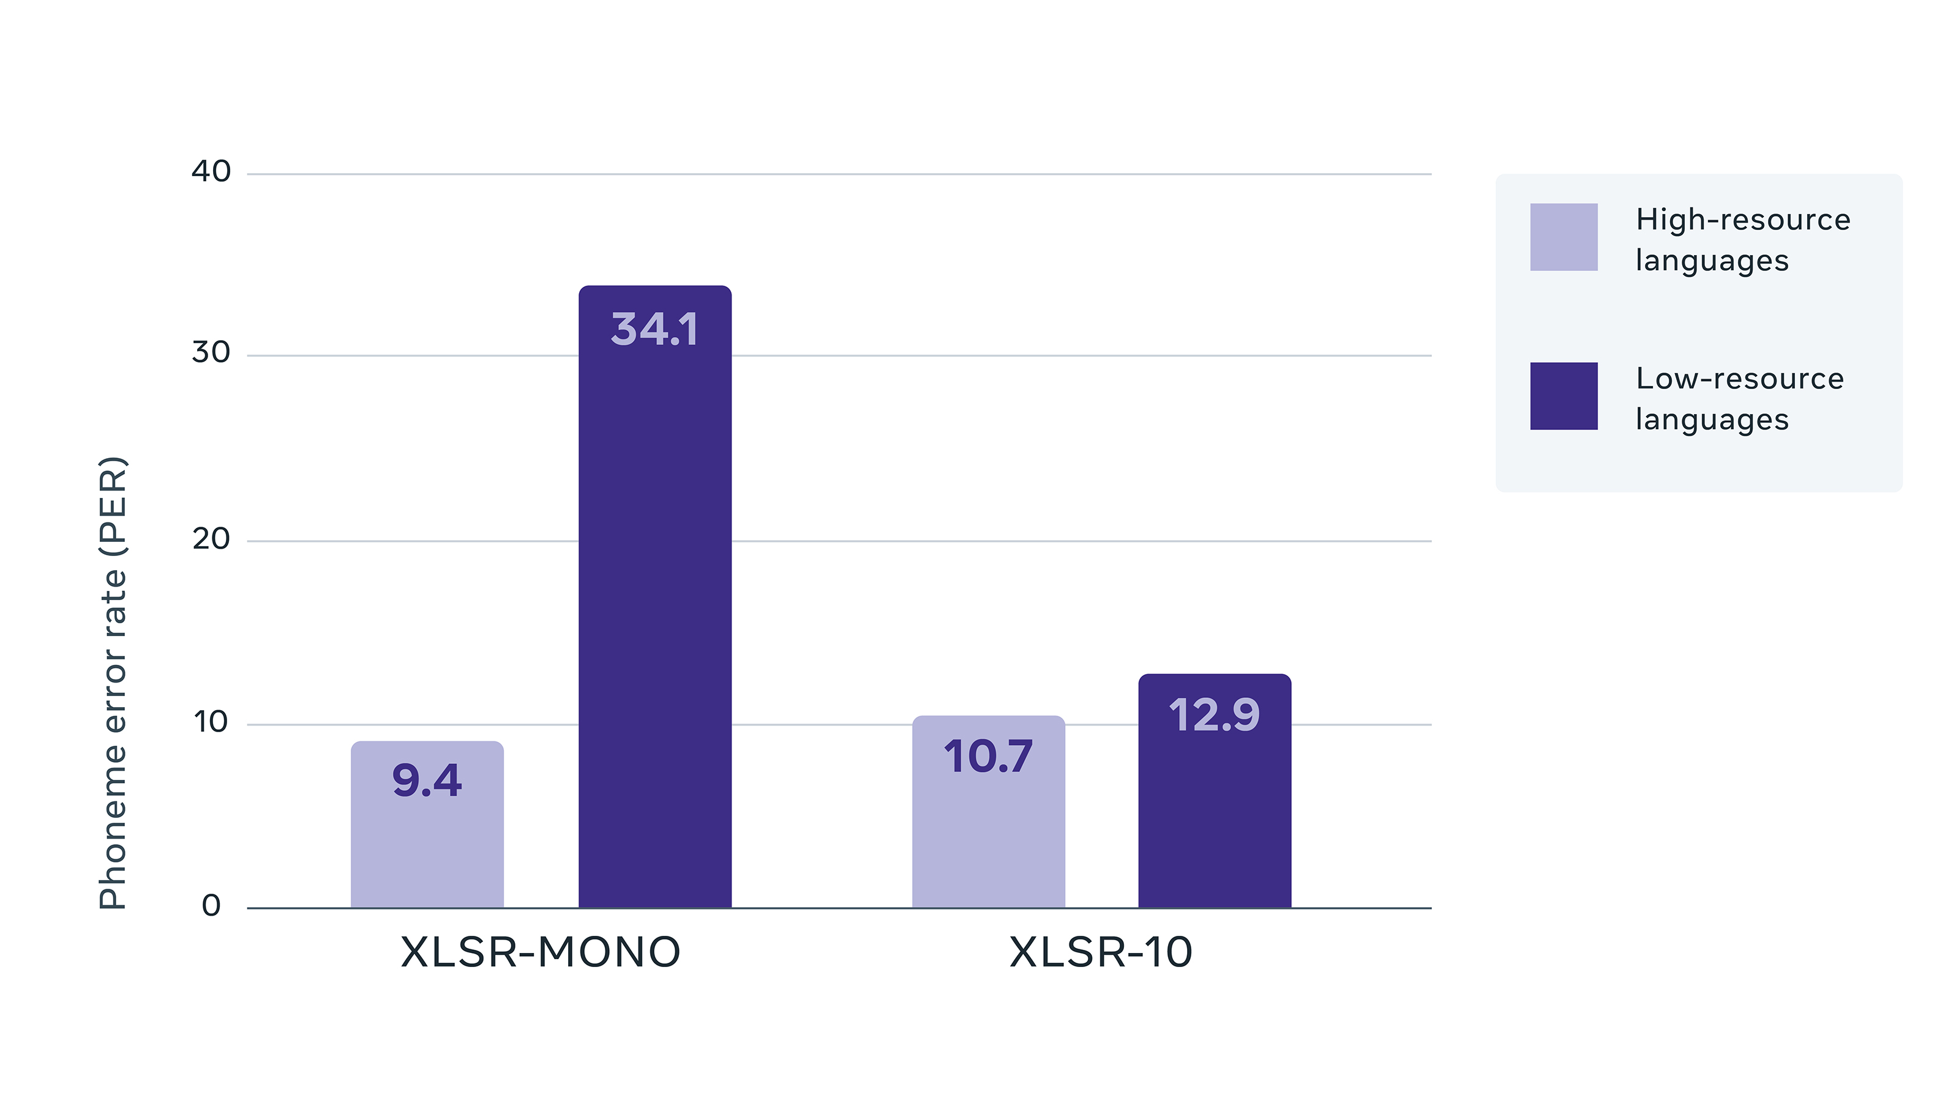
Cross-linguality
Wav2vec 2.0 is also trained on unannotated speech audio of 12 languages from the Common Voice benchmark.
Cross-lingual training dramatically improves performance on low-resource languages, compared with training only on a single language
https://arxiv.org/pdf/2006.13979.pdf

Slide 37
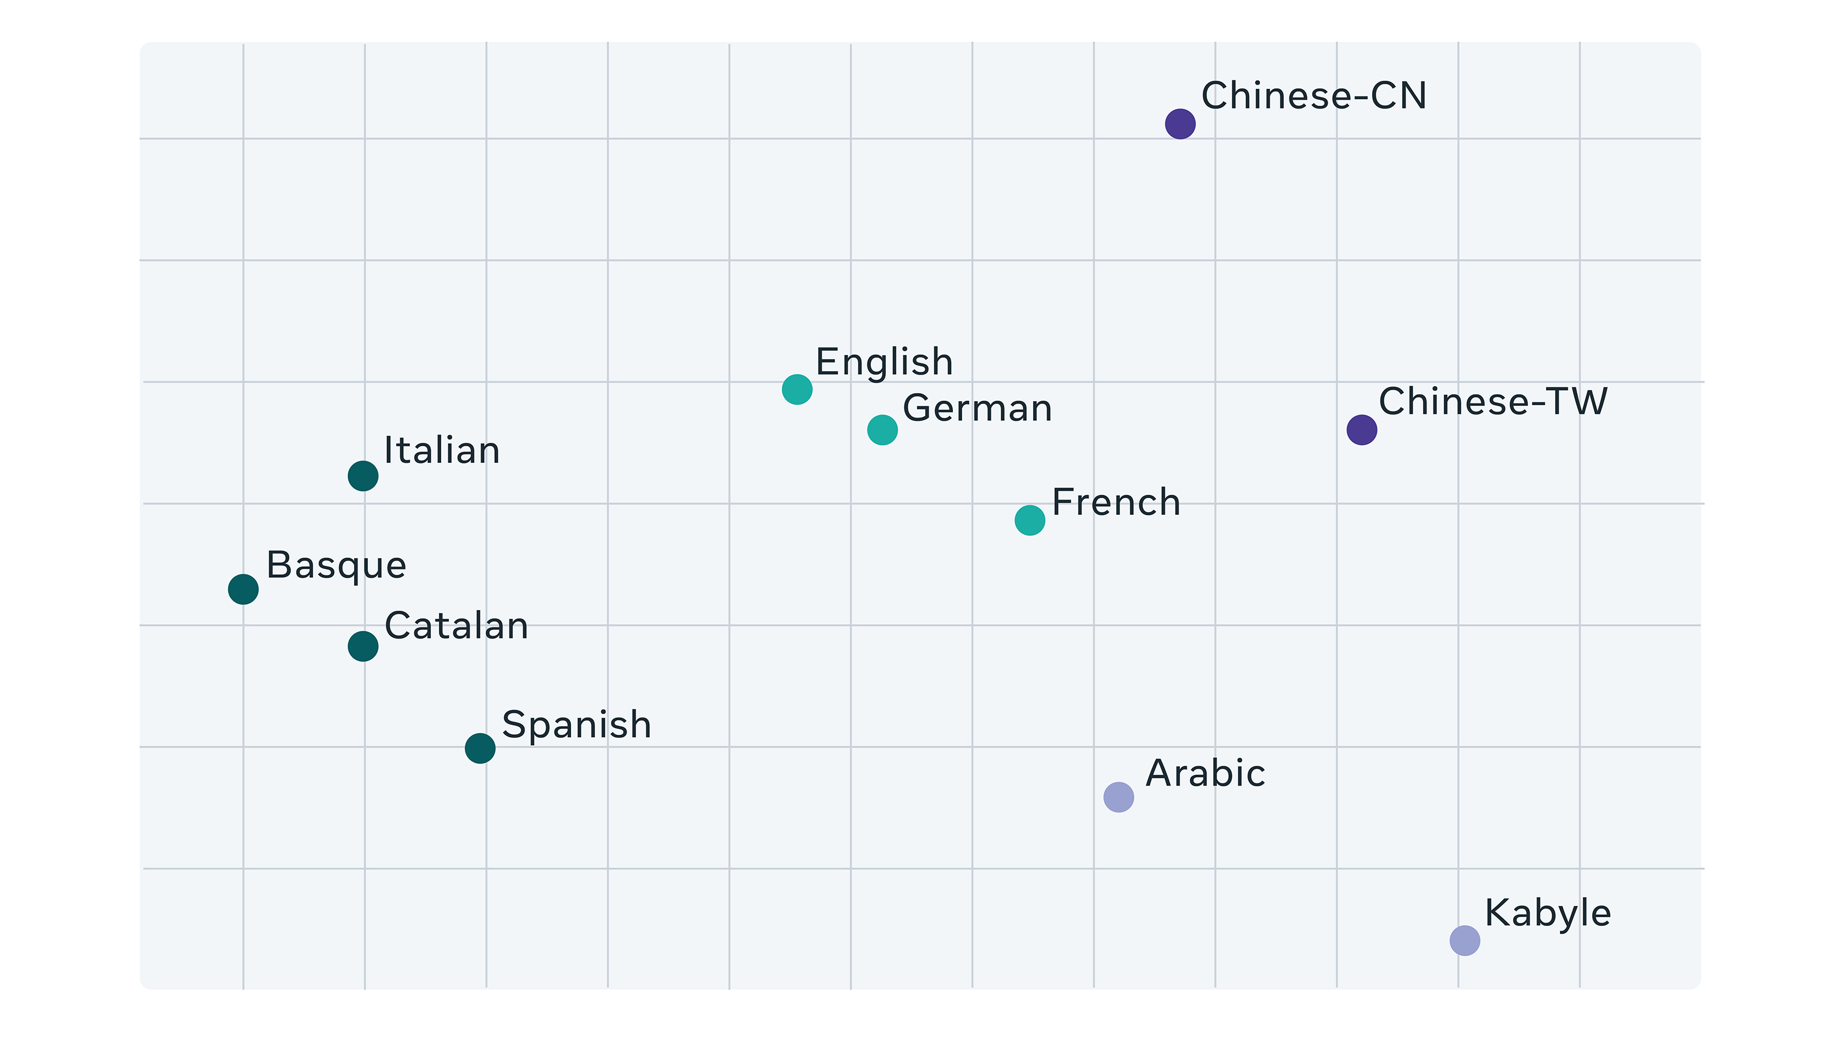
https://arxiv.org/pdf/2006.13979.pdf
Notes:
his illustration shows that related languages tend to use similar units, which confirms that our model learns cross-lingual units.

Slide 38
Wav2vec2 Models
 | wav2vec2-base-960h | wav2vec2-large-960h | wav2vec2-large-960h-lv60 | wav2vec2-large-960h-lv60-ST
 | BASE contains 12 transformer blocks 250k audio samples, or 15.6sec | LARGE contains 24 transformer blocks 320K audio samples, or 20 sec | pretrained and fine-tuned on 960 hours of Libri-Light and Librispeech on 16kHz | 1 Model was trained with Self-Training objective
WER- Clean | 2.1 | 2.0 | 1.8 | 1.5
WER- Other | 4.8 | 4.1 | 3.3 | 3.1
1. Qiantong Xu et al., 2021

Slide 39
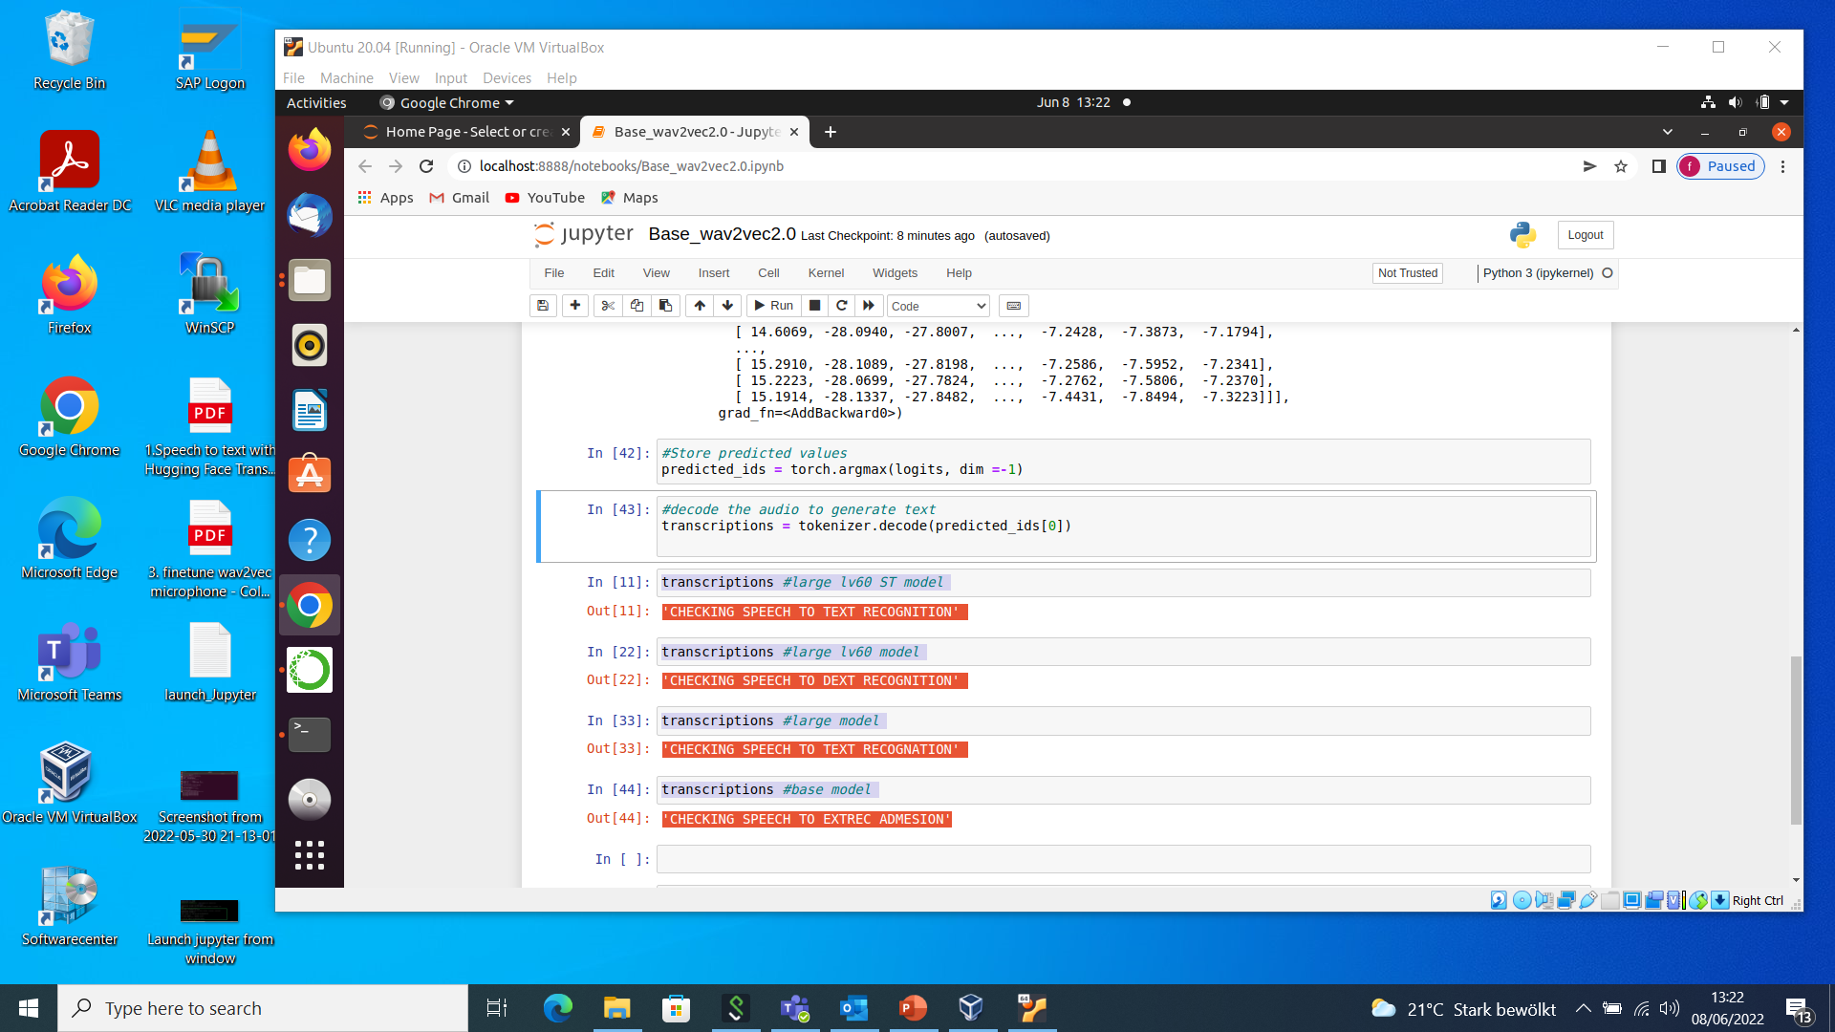

Slide 40
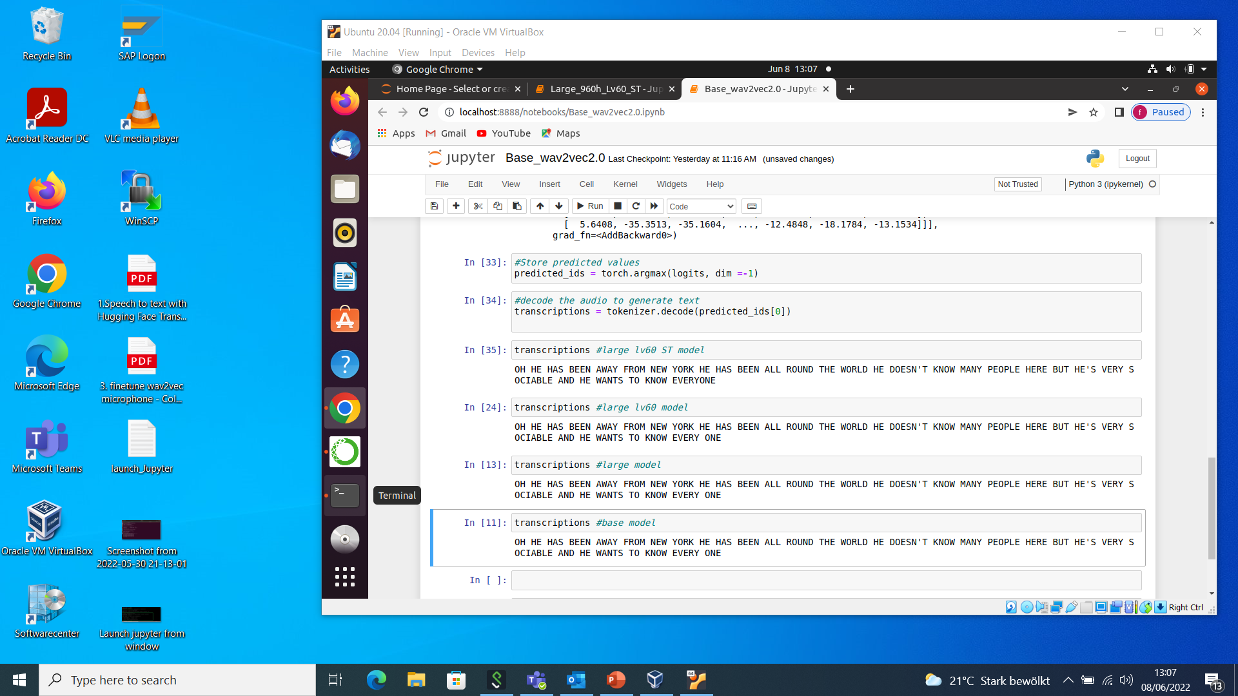

Slide 41

it wasn't like i was asking for the code to a nuclear bunker or anything like that but the amount of resistance i got from this. Sample-Audio-1
It was not like I was asking for the code to a newclear bunker or anything like that but the a maunt of resistance i got from miss (0.551 s)
It was not like I was asking for the cod to a new clear bunker or anything like that but the amount of resistance i got from this (1.044 s)
It wasn't like I was asking for the code to a nclear bunker or anything like that but the amount of resistance i got from this (1.167 s)
It wasn't like I was asking for the code to a nuclear bunker or anything like that but the amount of resistance i got from this (1.106 s)

Slide 42
“Oh, he has been away from New York—he has been all round the world. He doesn't know many people here, but he's very sociable, and he wants to know every one.” Sample-Audio-2
Oh he has been away from new york he has been all round the world he doesn't know many people here but he's very sociable and he wants to know every one (0.667 s)
Oh he has been away from new york he has been all round the world he doesn't know many people here but he's very sociable and he wants to know every one (1.560 s)
Oh he has been away from new york he has been all round the world he doesn't know many people here but he's very sociable and he wants to know every one (2.214 s)
Oh he has been away from new york he has been all round the world he doesn't know many people here but he's very sociable and he wants to know everyone (1.406 s)

Slide 43
chances are that they are rooted in the productivity crisis Sample-Audio-3
Chances are that they are rutedi the prodetivity crizes (0.348 s)
Chances are that they are rooted in the productivity crises (0.747 s)
Chances are that they are rooted in the productivity crisis (0.767 s)
Chances are that they are rooted in the productivity crisis (0.706 s)

Slide 44
"SWEAT COVERED BRION'S BODY TRICKLING INTO THE TIGHT LOWING CLOTH THAT WAS THE ONLY GARMENT HE WORE"
"SWEAT COVERED BRION'S BODY TRICKLING INTO THE TIGHT LOIN CLOTH THAT WAS THE ONLY GARMENT HE WORE"
"SWEAT COVERED BRION'S BODY TRICKLING INTO THE TIGHT LOIN CLOTH THAT WAS THE ONLY GARMENT HE WORE"
"SWEAT COVERED BRION'S BODY TRICKLING INTO THE TIGHT LOIN CLOTH THAT WAS THE ONLY GARMENT HE WORE"

Slide 45
I am checking the performance of speech to text recognition
I am checking the performance of speech to extrecognition (0.458 s)
I am taking the performance of speech to text recognition (1.144 s)
I am checking the performance of speech to dext recognition (1.542 s)
I am checking the performance of speech to text recognition (1.157s)

Slide 46
Learn powerful representations from speech audio
LEN OUR FORTHE REPRESENTATIONS FROM SPEECH AUDUE (0.594 s)
LEARN POWERFUL REPRESENTATIONS FROM SPEECH ARDU (0.979 s)
LEARN POWERFUL REPRESENTATIONS FROM SPEECH ODIO (1.943 s)
LEARN POWERFUL REPRESENTATIONS FROM SPEECH AUDIO(1.143s)

Slide 47
Our speech is our identity
Notes:
Our voice is also unique like our looks, fingerprints and it also identifies us.
https://paperswithcode.com/sota/automatic-speech-recognition-on-librispeech-2
https://paperswithcode.com/sota/speech-recognition-on-librispeech-test-clean

Slide 48
THANK YOU

Slide 49
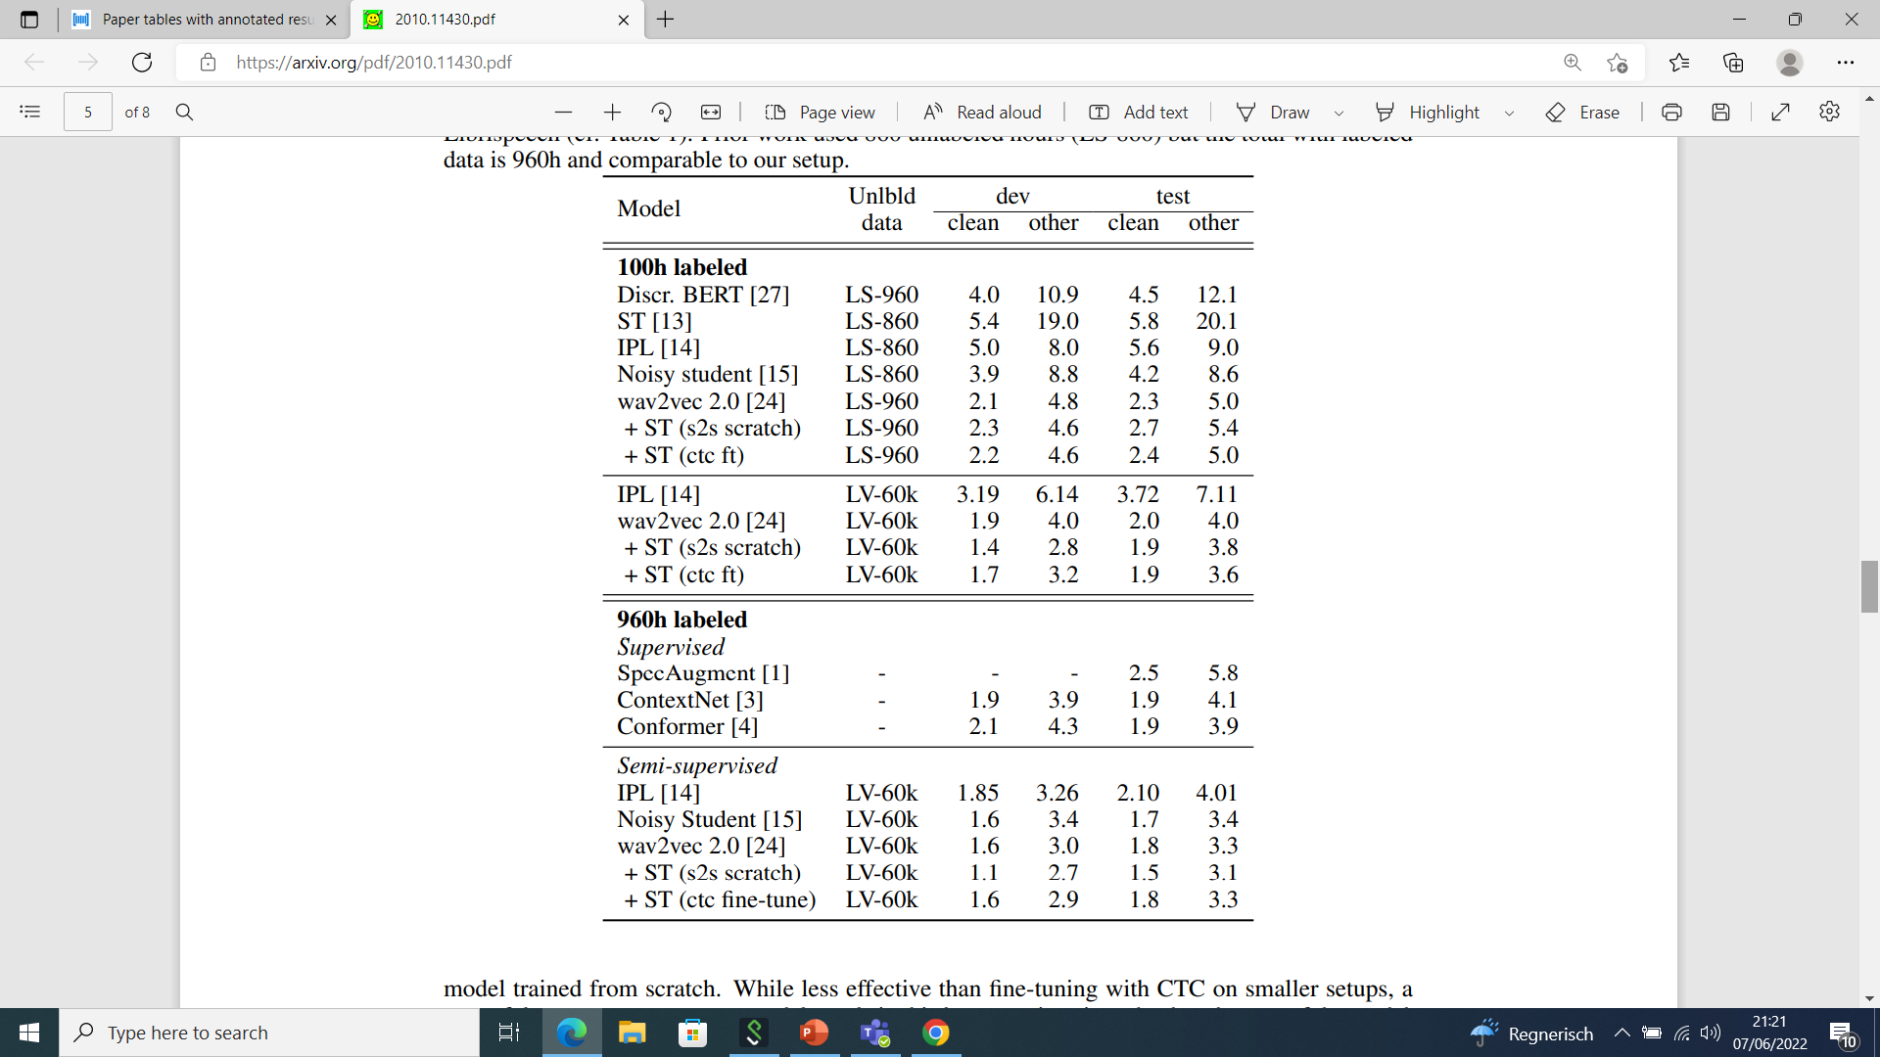
A powerful sequence to sequence model excels in the larger setup The lower performance of fine tuning is likely due to CTC not being as competitive as more elaborate sequence to sequence models when a lot of pseudo-labeled data is available
Notes:
Prior work used 860 unlabeled hours (LS-860) but the total with labeled data is 960h and comparable to our setup.

Slide 50
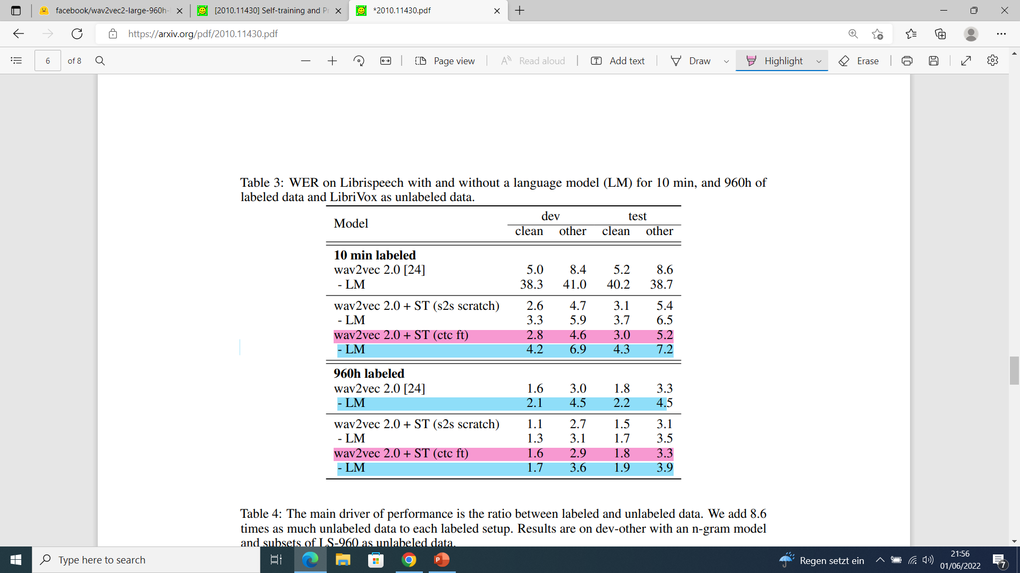
As more labeled data becomes available, the performance of the acoustic model without a language model improves Generally, the S2S model in the (scratch) setting is better as compared to the CTC model used in fine-tuning
Notes:
combined training models have very good performance even without a language model.

